Slide 1
10. Supplementary Topics

Slide 2
10. Supplementary Topics - General
Program Designing Approaches:
Code Efficiency: Processing Load, Time, and Memory
Introduction to Simulink
Introduction to GUI
Top-Down
Bottom-Up
Combined

Slide 3
10. Supplementary Topics - Advanced
Principle Components Analysis (PCA)
Independent Components Analysis (ICA)
Fuzzy Concepts
Optimization Algorithms

Slide 4
10. Supplementary Topics – Biomedical Applications
Famous Biomedical Signal and Image Datasets
Toolboxes: Biosig, eeglab, Psychtoolbox, …
FT, DFT, STFT, FFT, power spectrum, Wavelet, Cepstrum
Auto-correlation, cross-correlation, convolution
Filters and Signal Pre-Processing Techniques
Digital Image Processing
Features and Statistical Pattern Recognition
Machine Learning: Supervised/Unsupervised

Slide 5
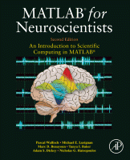

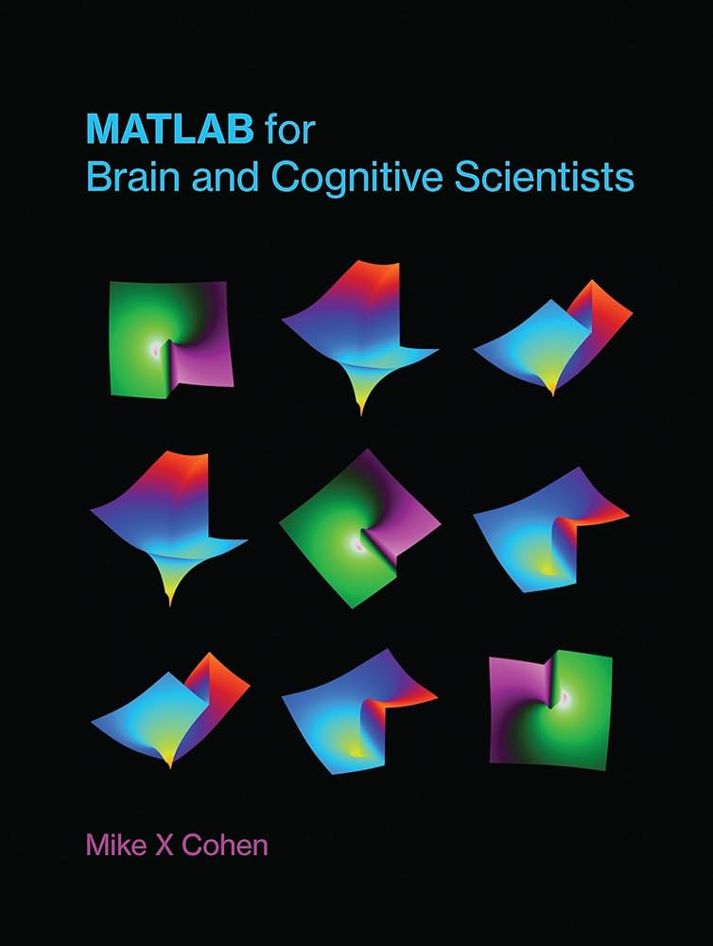
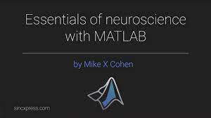
10. Supplementary Topics - Further Resources
Mohammad Nourizadeh Cherloo
onlinebme.com
https://www.mathworks.com/matlabcentral/fileexchange/154381-essentials-of-neuroscience-with-matlab

